Slide 1

KS1 Changes
2024 / 2025
Y1/2 Mixed Year Group

Slide 2

Context and Reasoning
The national and local demographic has seen and is projected to see significant reductions in pupil numbers.
2023 - 40
2024 - 42
2025 - 32
2026 - 36

Slide 3
What are the changes?
Based on our current and projected pupil numbers, from September 2024, we will be changing from two Year 1 and two Year 2 classes to 3 mixed-age Year 1 & 2 classes.
The class structure at Backwell Juniors will remain unchanged for the 24-25 academic year.

Slide 4
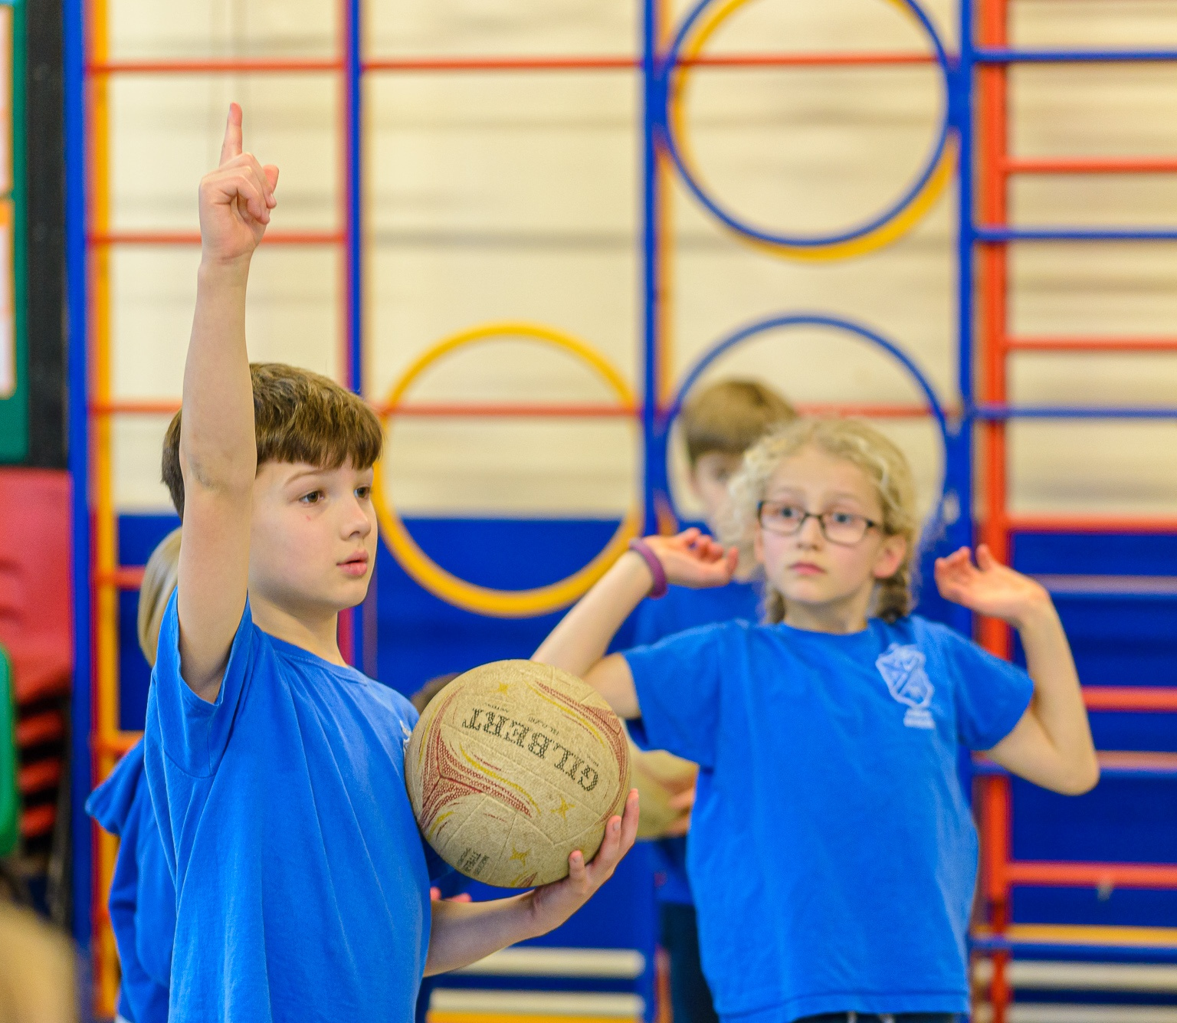
Your Questions so far
KS1 Structure Changes

Slide 5
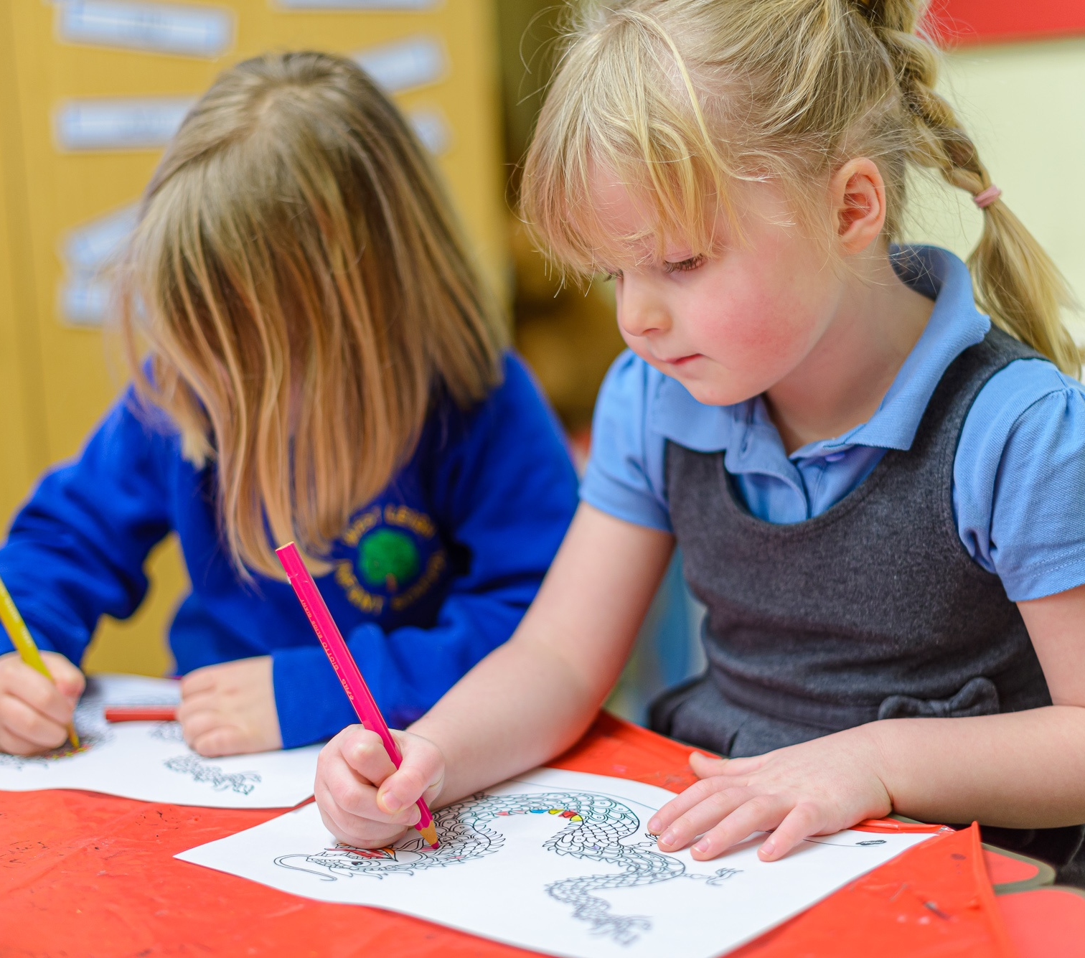
Why is this needed now if it's about falling numbers in Reception year?
Numbers have been falling for some time and are projected to continue to fall.
The EYFS curriculum and provision is quite different, so we are maintaining 2 R classes and mixing from Y1.

Slide 6

Transition from EYFS to KS1
Transition from the EYFS curriculum to the KS1 curriculum will be based on the needs of the children.
Last year’s transition period was three weeks.
Independent activity tables are similar to EYFS – art, construction, Maths, writing and ‘Tuff Tray’. There will be stretch activities available, particularly for Y2 pupils.
Teacher-led activities will increase in pupil numbers across the transition period. E.g. Four Year 1 pupils and 8 Year 2 pupils to begin with.
Year 2 pupils will be in the teacher-led group for an extended amount of time to ensure progression from their learning in Year1.

Slide 7
How will the classes be organised?
Letters will be sent out in Term 6.
Children will be able to choose three friends they would like to be in the same class with.
They will be with at least one of their chosen friends.
Classes will be confirmed the day before ‘Move-up Morning’ (we expect Move-up Morning to be on Tuesday 2nd July).
Children currently have lunchtime together as a whole school which has already helped to build relationships between year groups.

Slide 8
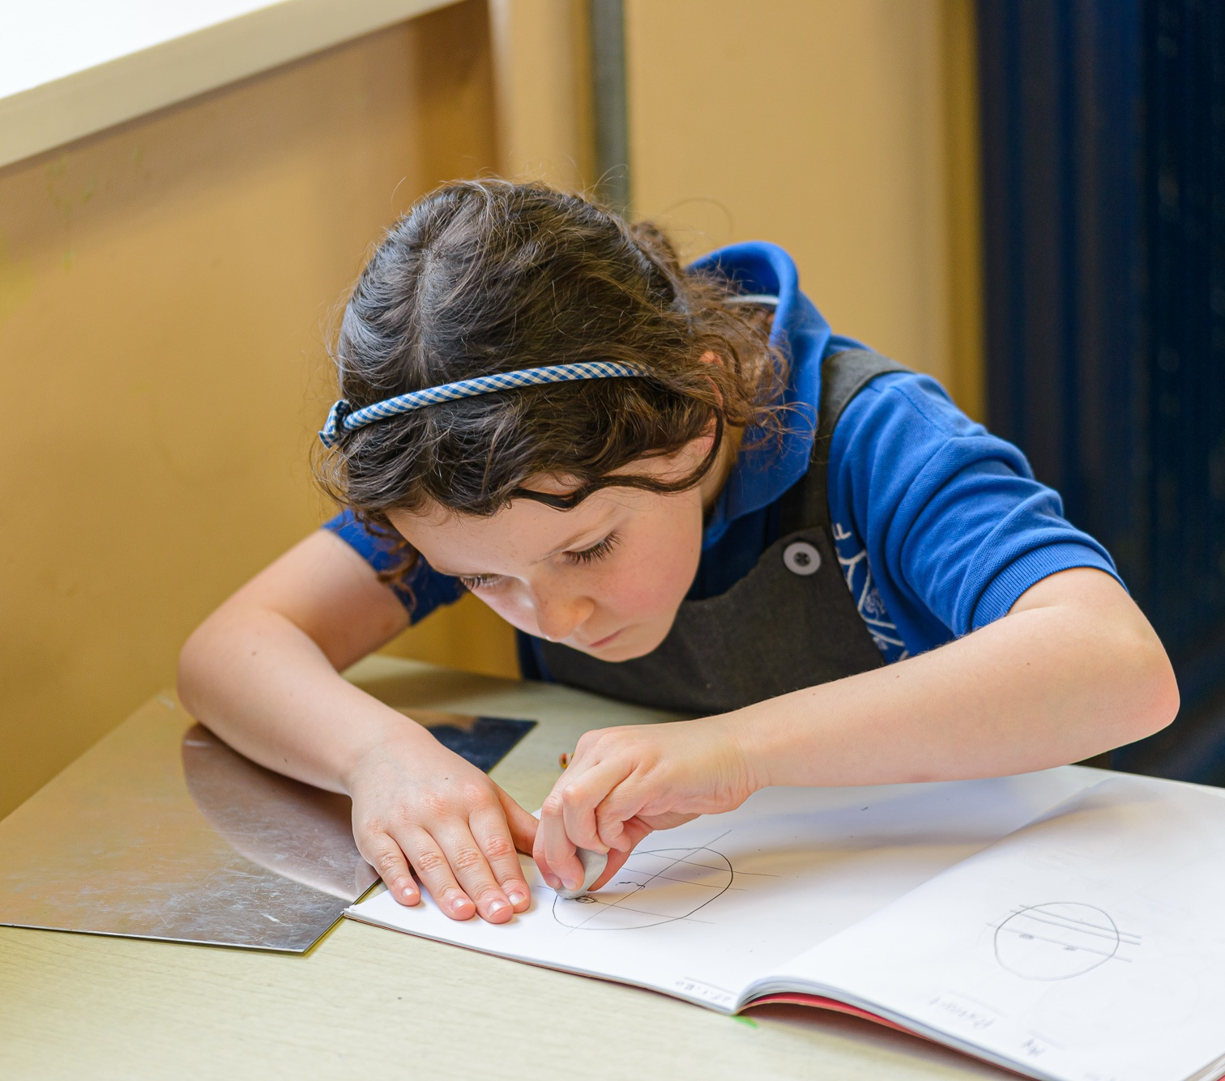
What are benefits of mixed aged classes for the oldest members?
There is no evidence that suggests mixed-age classrooms have a negative impact on progress or attainment.
Studies have shown children in mixed year groups thrive socially and emotionally.
Mixed-age classes encourage a spirit of cooperation where learners are more likely to support each other than compete. Over time, learners become a ‘family of learners’ who support and care for each other.
Children in these classes therefore show a notable increase in self-esteem.

Slide 9

What are benefits of mixed aged classes for the oldest members?
Giving older learners the chance to support younger learners builds their confidence and leadership skills. The younger learners also benefit as they see their older peers modelling positive behaviour.
These children model more sophisticated approaches to problem solving, helping younger children to accomplish tasks they would not be able to do independently whilst completing their own learning. This dynamic increases the older child’s level of independence and competence while increasing the younger child’s spirit of belonging in a community of learners.

Slide 10
What happens when they move to year 3 and beyond? What's the longer term plan?
Nothing has been decided yet, but if numbers do not increase, there is potential that the class structure at BJS will also need to be adjusted in time.

Slide 11
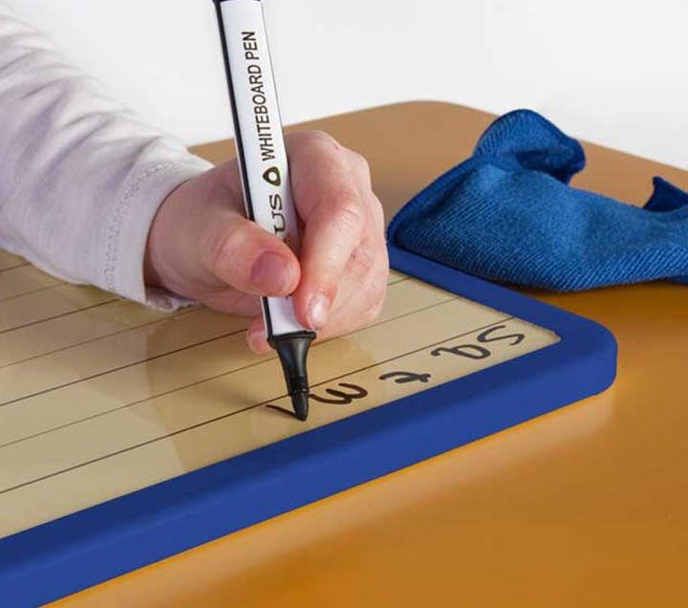
What will the curriculum look like?
Learning Without Limits – support and challenge for all.
Phonics (Y1) and SPaG (Y2) will be streamed.
Two-Year cycle ensuring the whole KS1 curriculum is covered without repetition.

Slide 12
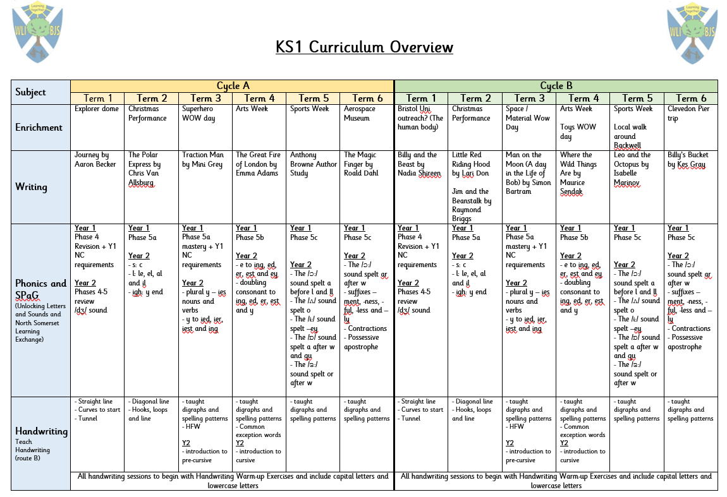
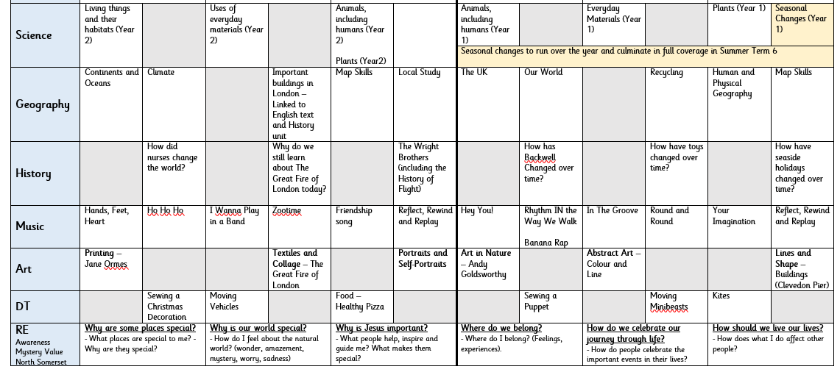
What will the curriculum look like?

Slide 13
What will the curriculum look like?

Slide 14
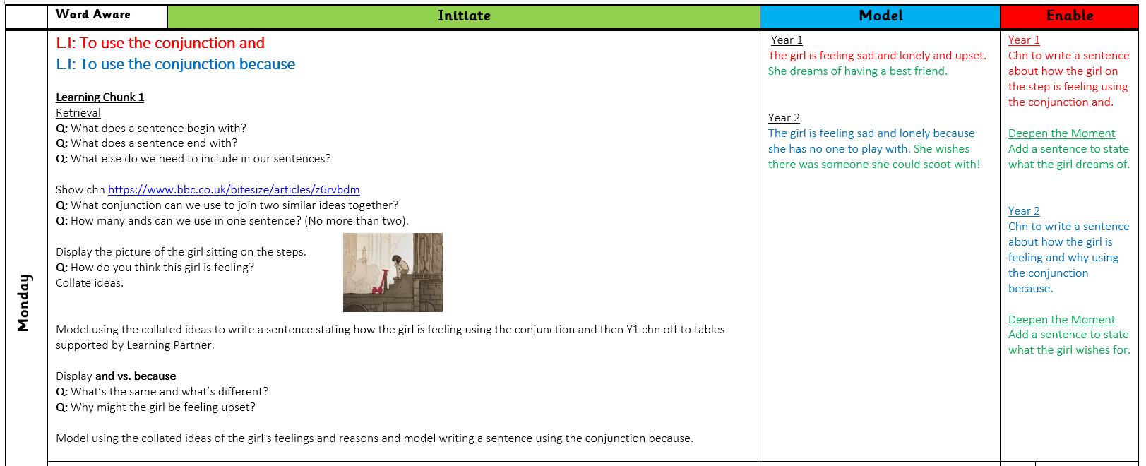
Example English Lesson (chunk 1)

Slide 15
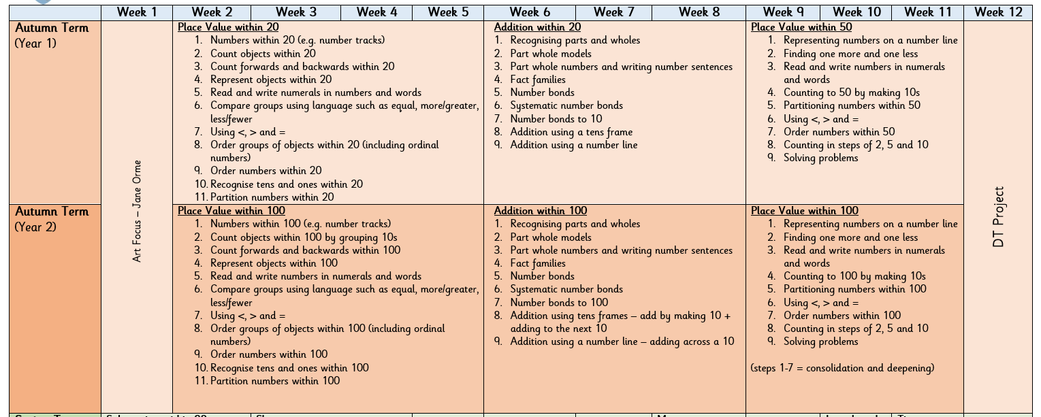
Teaching Maths

Slide 16
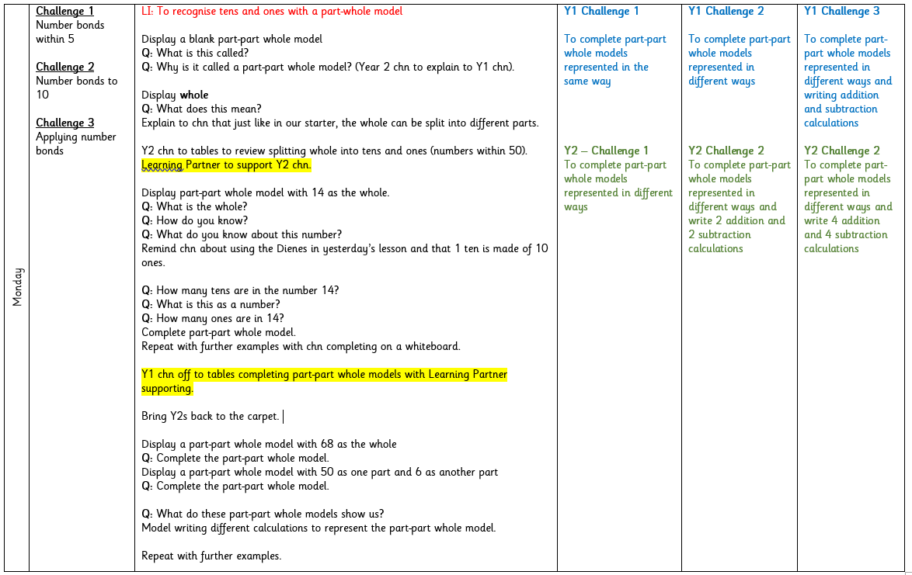
Example Maths Lesson

Slide 17
Questions?
KS1 Mixed Year Groups

